Slide 1
Cornerstone City Church Peninsula Plus Community Hoo Are Ya
08-10-2023

Slide 2
Our God Saves
CCLI Song # 4972837
Brenton Brown | Paul Baloche
© 2007 Integrity's Hosanna! Music (Admin. by Integrity Music Ltd)
Leadworship Songs (Admin. by Integrity Music Ltd)
Thankyou Music (Admin. by Integrity Music Ltd)
For use solely with the SongSelect® Terms of Use. All rights reserved. www.ccli.com
CCLI Licence No. 33265

Slide 3
1/3
In the name of the Father
In the name of the Son
In the name of the Spirit,
Lord we come
We're gather'd together,
To lift up Your name
To call on our Savior to fall on Your grace

Slide 4
2/3
Hear the joyful sound of our offering
As Your saints bow down
As Your people sing
We will rise with You lifted on Your wings
And the world will see that

Slide 5
3/3
Our God saves our God saves
There is hope in Your name
Mourning turns to songs of praise
Our God saves our God saves

Slide 6
This Is Amazing Grace
CCLI Song # 6333821
Jeremy Riddle | Josh Farro | Phil Wickham
© 2012 WC Music Corp. (Admin. by / Small Stone Media BV, Holland (Admin. in the UK/Eire by Song Solutions www.songsolutions.org))
Bethel Music Publishing (Admin. by Song Solutions)
Phil Wickham Music (Admin. by Song Solutions www.songsolutions.org)
Seems Like Music (Admin. by Song Solutions www.songsolutions.org)
Sing My Songs (Admin. by Song Solutions www.songsolutions.org)
For use solely with the SongSelect® Terms of Use. All rights reserved. www.ccli.com
CCLI Licence No. 33265

Slide 7
1/7
Who breaks the power of sin and darkness
Whose love is mighty and so much stronger
The King of Glory the King above all kings

Slide 8
2/7
Who shakes the whole earth with holy thunder
And leaves us breathless in awe and wonder
The King of Glory the King above all kings

Slide 9
3/7
This is amazing grace
This is unfailing love
That You would take my place
That You would bear my cross
You laid down Your life
That I would be set free
Oh Jesus I sing for all that You've done for me

Slide 10
4/7
Who brings our chaos back into order
Who makes the orphan a son and daughter
The King of Glory the King above all kings

Slide 11
5/7
Who rules the nations with truth and justice
Shines like the sun in all of its brilliance
The King of Glory the King above all kings

Slide 12
6/7
This is amazing grace
This is unfailing love
That You would take my place
That You would bear my cross
You laid down Your life
That I would be set free
Oh Jesus I sing for all that You've done for me

Slide 13
7/7
Worthy is the Lamb who was slain
Worthy is the King who conquered the grave
Worthy is the Lamb who was slain
Worthy is the King who conquered the grave
Worthy is the Lamb who was slain
Worthy is the King who conquered the grave
Worthy is the Lamb who was slain
Worthy worthy worthy

Slide 14


Slide 15
Raise A Hallelujah
CCLI Song # 7119315
Jake Stevens | Jonathan David Helser | Melissa Helser | Molly Skaggs
© 2018 Bethel Music Publishing (Admin. by Song Solutions)
For use solely with the SongSelect® Terms of Use. All rights reserved. www.ccli.com
CCLI Licence No. 33265

Slide 16
1/8
I raise a hallelujah in the presence of my enemies I raise a hallelujah louder than the unbelief I raise a hallelujah my weapon is a melody I raise a hallelujah Heaven comes to fight for me

Slide 17
2/8
I’m gonna sing in the middle of the storm Louder and louder you’re gonna hear my praises roar Up from the ashes hope will arise Death is defeated the King is alive

Slide 18
3/8
I raise a hallelujah with everything inside of me I raise a hallelujah I will watch the darkness flee I raise a hallelujah in the middle of the mystery I raise a hallelujah fear you lost your hold on me

Slide 19
4/8
Sing a little louder (Sing a little louder) Sing a little louder (Sing a little louder)

Slide 20
5/8
Sing a little louder in the presence of my enemies Sing a little louder louder than the unbelief Sing a little louder my weapon is a melody Sing a little louder Heaven comes to fight for me

Slide 21
6/8
Sing a little louder in the presence of my enemies Sing a little louder louder than the unbelief Sing a little louder my weapon is a melody Sing a little louder

Slide 22
7/8
I’m gonna sing in the middle of the storm Louder and louder you’re gonna hear my praises roar Up from the ashes hope will arise Death is defeated the King is alive

Slide 23
8/8
I raise a hallelujah I raise a hallelujah I raise a hallelujah I raise a hallelujah

Slide 25
I Speak Jesus
CCLI Song # 7136201
Abby Benton | Carlene Prince | Dustin Smith | Jesse Reeves | Kristen Dutton | Raina Pratt
© 2019 Here Be Lions Publishing (Admin. by Integrity Music Ltd)
Integrity's Praise! Music (Admin. by Integrity Music Ltd)
BEC Worship (Admin. by Song Solutions)
Raina Pratt publishing designee (Admin. by Song Solutions www.songsolutions.org)
WriterWrong Music (Admin. by Song Solutions www.songsolutions.org)
Remaining portion is unaffiliated
For use solely with the SongSelect® Terms of Use. All rights reserved. www.ccli.com
CCLI Licence No. 33265

Slide 26
1/5
I just want to speak the Name of Jesus
Over ev'ry heart and ev'ry mind
'Cause I know there is peace within Your presence
I speak Jesus

Slide 27
2/5
I just want to speak the Name of Jesus
'Til ev'ry dark addiction starts to break
Declaring there is hope and there is freedom
I speak Jesus

Slide 28
3/5
('Cause) Your Name is power
Your Name is healing
Your Name is life
Break ev'ry stronghold
Shine through the shadows
Burn like a fire

Slide 29
4/5
I just want to speak the Name of Jesus
Over fear and all anxiety
To ev'ry soul held captive by depression
I speak Jesus

Slide 30
5/5
Shout Jesus from the mountains
Jesus in the streets
Jesus in the darkness over ev'ry enemy
Jesus for my fam'ly
I speak the holy Name Jesus

Slide 32


Slide 33
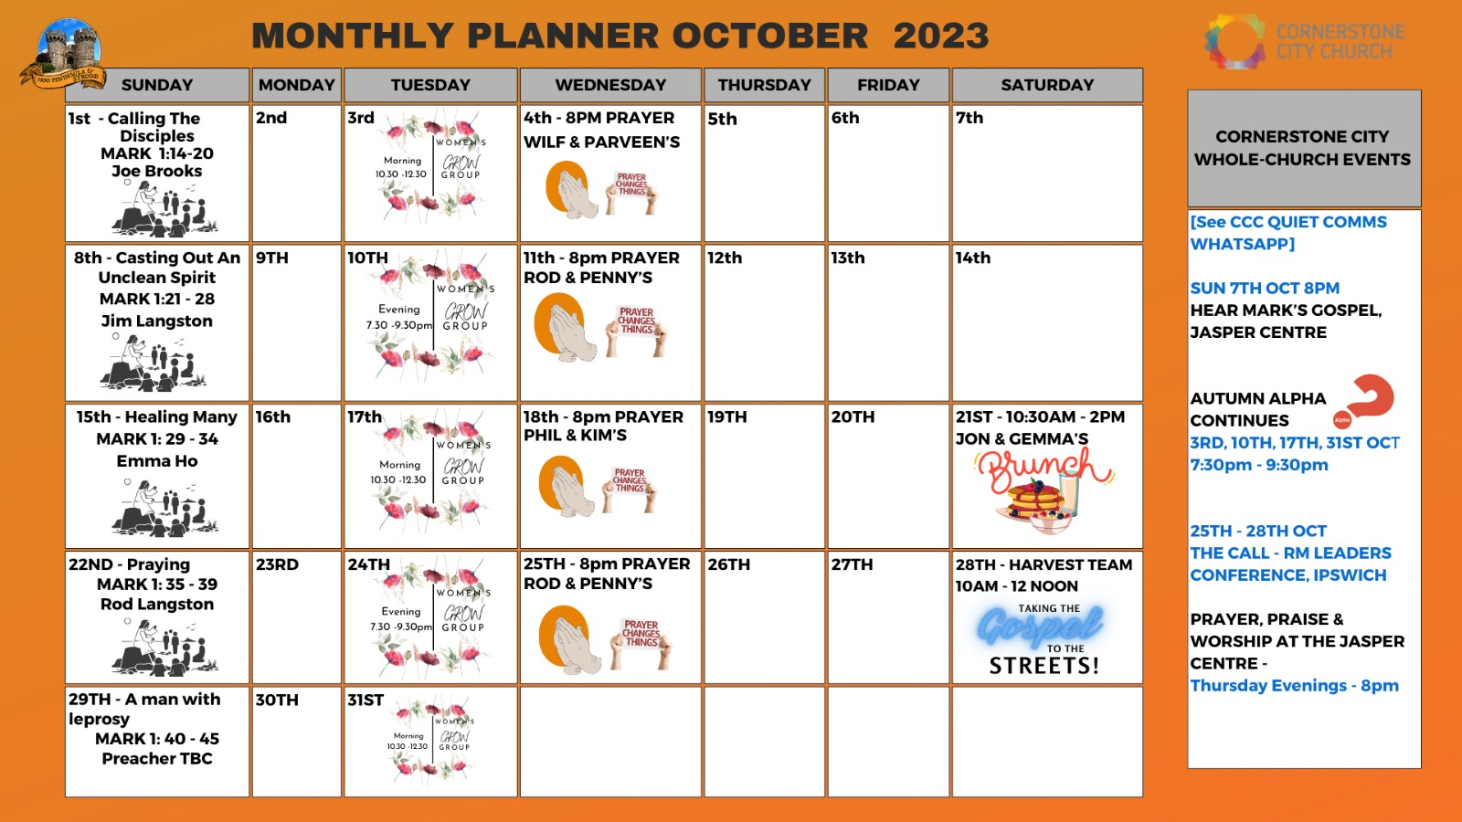

Slide 34


Slide 35
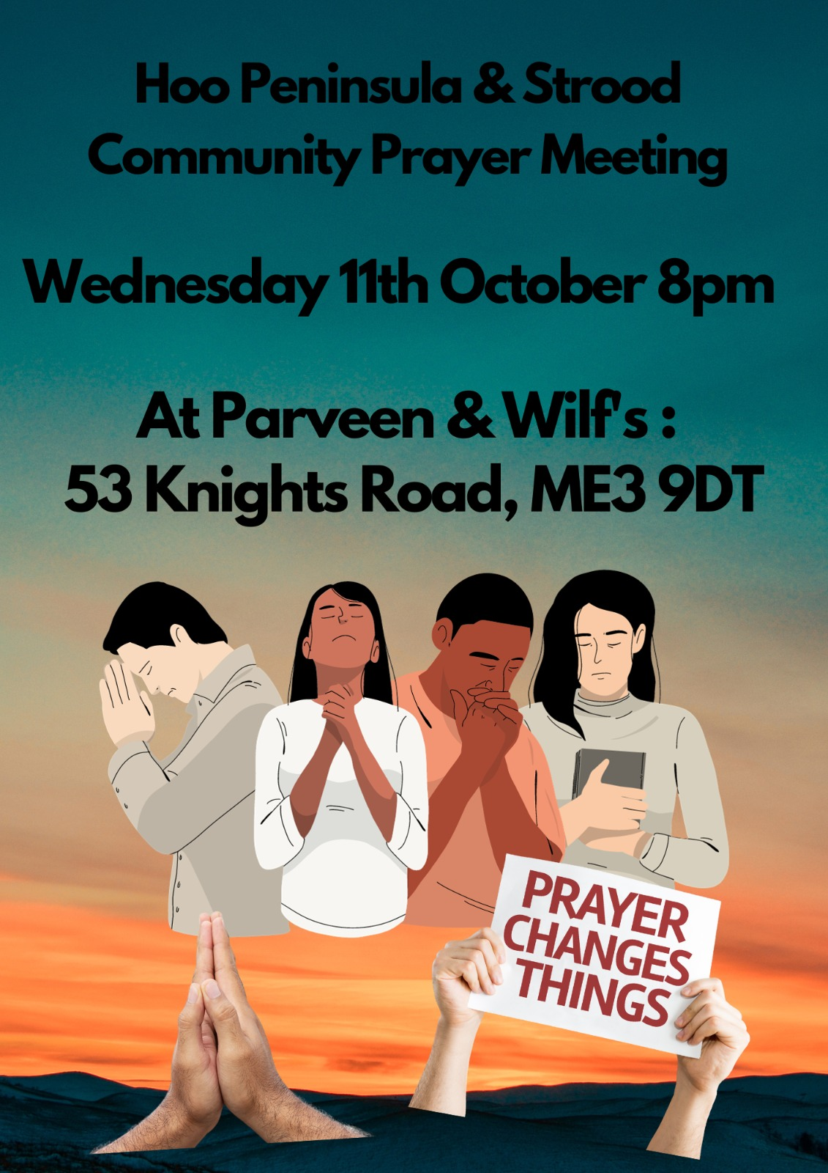

Slide 36
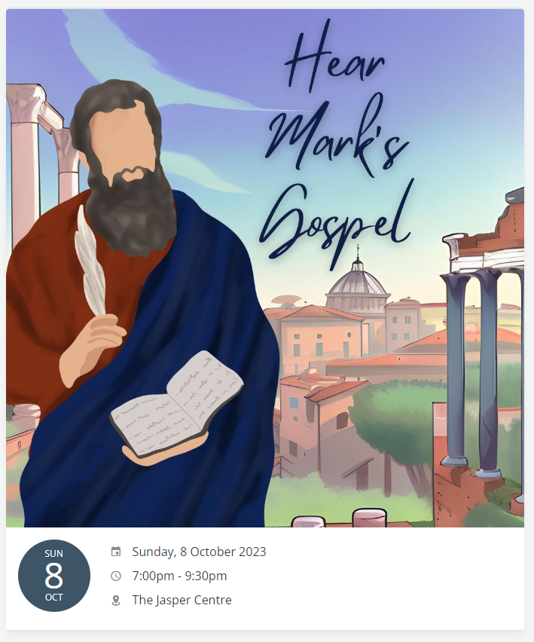

Slide 37


Slide 38


Slide 39
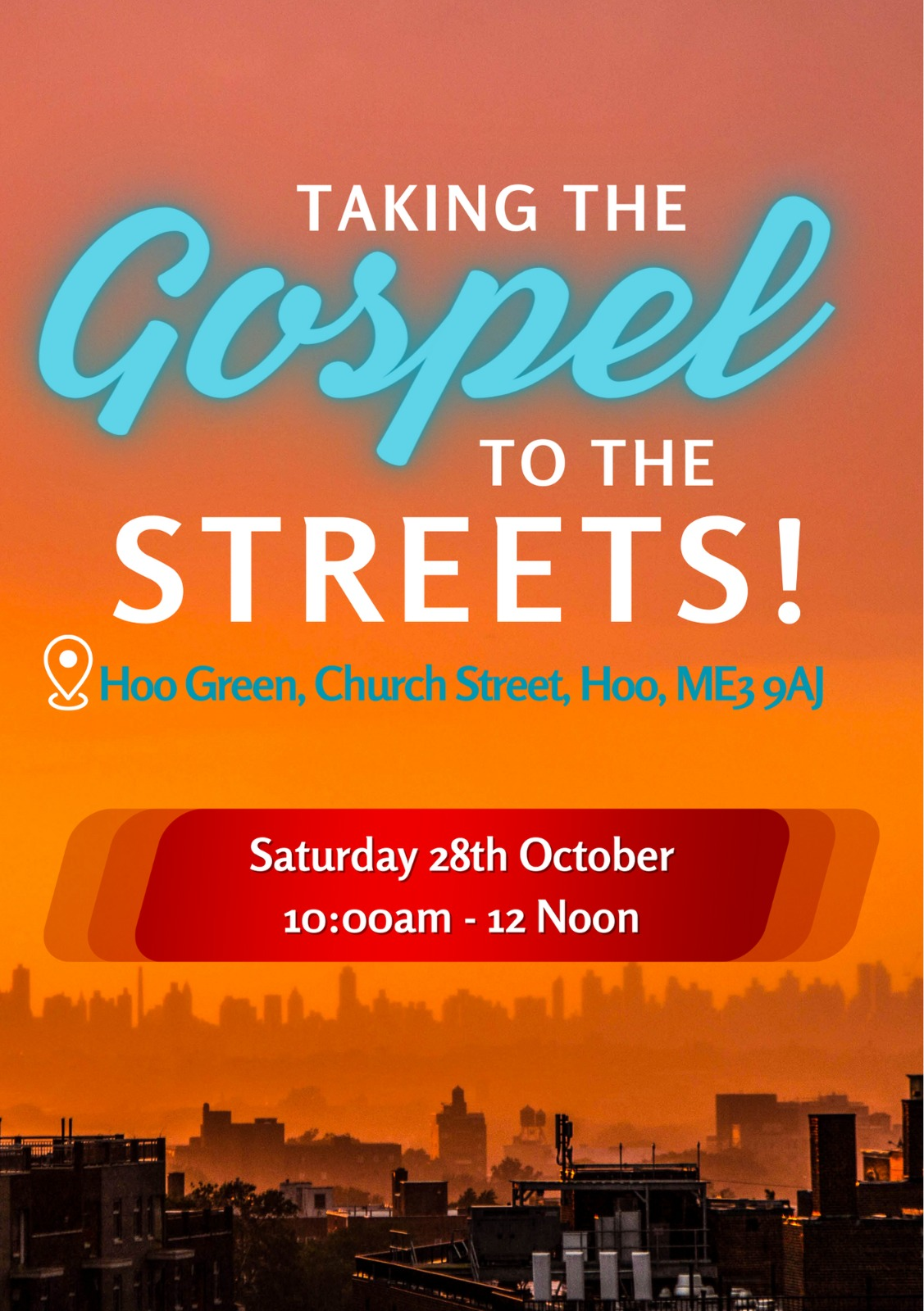

Slide 40
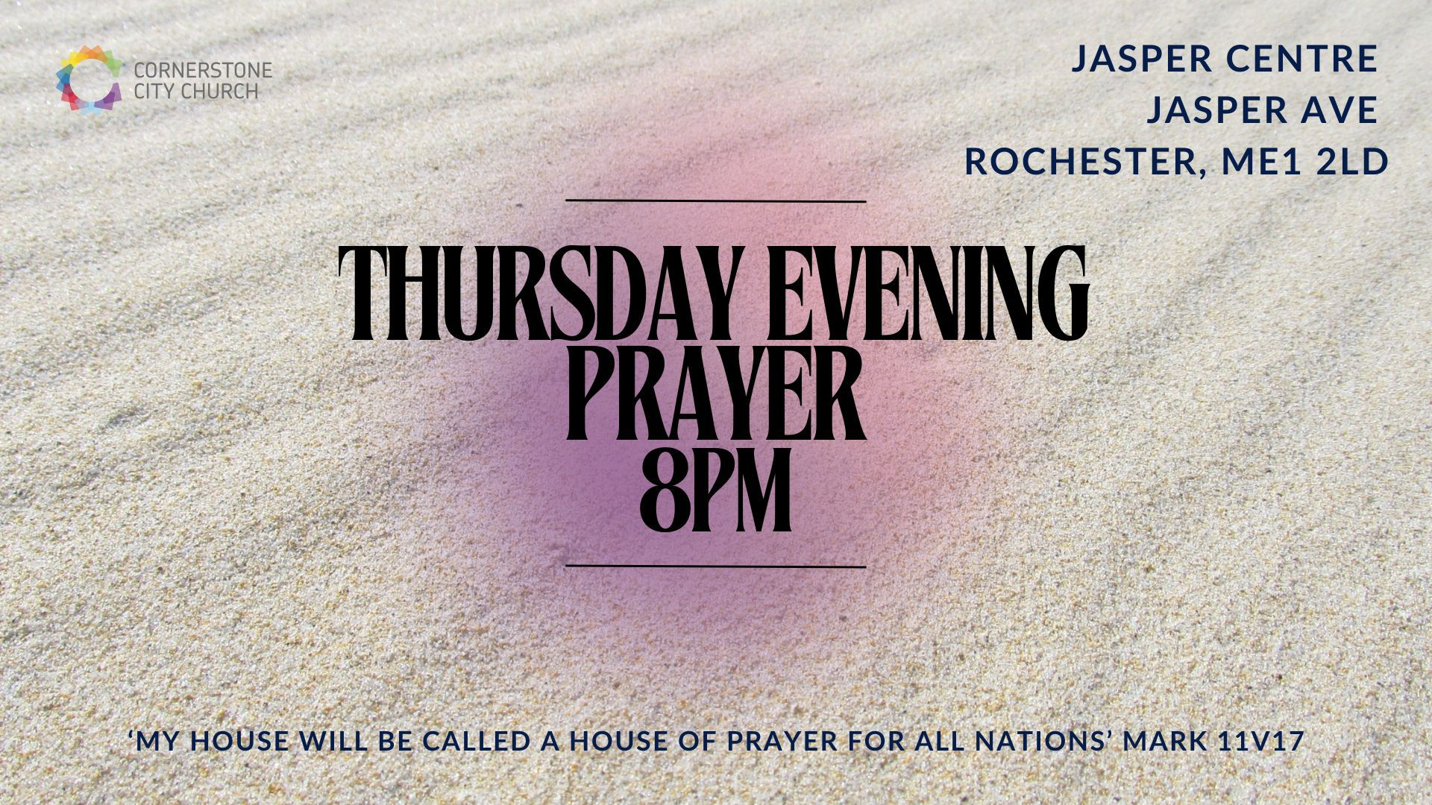

Slide 41


Slide 42


Slide 43
Ever Be
CCLI Song # 7030065
Bobby Strand | Chris Greely | Gabriel Wilson | Kalley Heiligenthal
© 2014 Bethel Music Publishing (Admin. by Song Solutions)
For use solely with the SongSelect® Terms of Use. All rights reserved. www.ccli.com
CCLI Licence No. 33265

Slide 44
1/8
Your love is devoted like a ring of solid gold
Like a vow that is tested like a covenant of old
Your love is enduring through the winter rain
And beyond the horizon with mercy for today

Slide 45
2/8
Faithful You have been and faithful You will be
You pledge Yourself to me and it’s why I sing

Slide 46
3/8
Your praise will ever be on my lips
Ever be on my lips
Your praise will ever be on my lips
Ever be on my lips
(REPEAT)

Slide 47
4/8
You Father the orphan
Your kindness makes us whole
You shoulder our weakness
And Your strength becomes our own

Slide 48
5/8
You’re making me like You
Clothing me in white
Bringing beauty from ashes
For You will have Your bride

Slide 49
6/8
Free of all her guilt and rid of all her shame
And known by her true name and it’s why I sing

Slide 50
7/8
Your praise will ever be on my lips
Ever be on my lips
Your praise will ever be on my lips
Ever be on my lips
(REPEAT)

Slide 51
8/8
You will be praised You will be praised
With angels and saints we sing worthy are You Lord
You will be praised You will be praised
With angels and saints we sing worthy are You Lord
(REPEAT)

Slide 52
2 Corinthians 14 May the grace of the Lord Jesus Christ, and the love of God, and the fellowship of the Holy Spirit be with you all

